Slide 1

Bangladesh University 15/1, Iqbal Road, Mohammadpur, Dhaka–1207

Slide 2
Face Recognition Based Attendance Management System
Project-Supervisor : Md. Riaz Uddan
Lecturer, Department of CSE, Bangladesh University

Slide 3
Develop by Project
Md. Sairul Islam
Id: 201931055046
55th Bach Final Year
Student of Bangladesh University
Documentation

Slide 4



Presentation Outline
Introduction
Features
Using Language And Tools
Project Details
User Interface
Database Table
Objectives and Scope
Future Work
Conclusion

Slide 5

Introduction
This is online Face Recognition Based Attendance Management System created by using python. The traditional method of attendance marking is a tedious task in many schools and colleges. It is also an extra burden to the faculties who should mark the attendance by manually calling the names of students which might take about 5 minutes of the entire session. This is time-consuming. There are some chances of proxy attendance. Therefore, many institutes started deploying many other techniques for recording attendance like the use of Radio Frequency Identification (RFID), iris recognition, fingerprint recognition, and so on. However, these systems are queue based which might consume more time and are intrusive in nature. Face recognition has set an important biometric feature, which can be easily acquirable and is non-intrusive. Face recognition based systems are relatively oblivious to various facial expression. Face recognition system consists of two categories: verification and face identification. Face verification is a matching process, it compares images against the template face images and is a problems that compares query face images.

Slide 6

Features
Show Interface
Student Id
Student Name
Take Image
Train Image
Automatic Attendance

Slide 7

Using Language And Laibary
Python
Face recognition in python
Tkinter in python
Open CV
python pillow
Pandas
Excel

Slide 8
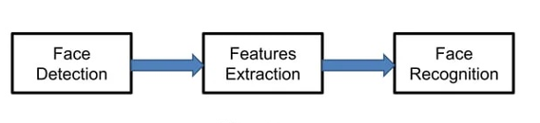
Diagram

Slide 9

User Interface

Slide 10

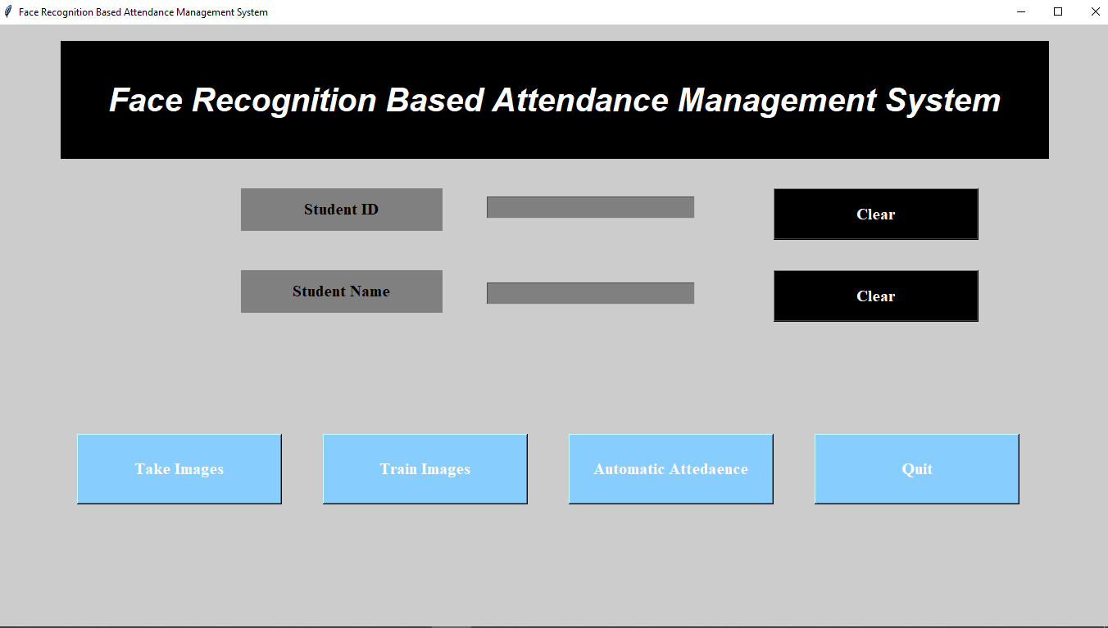

Slide 11
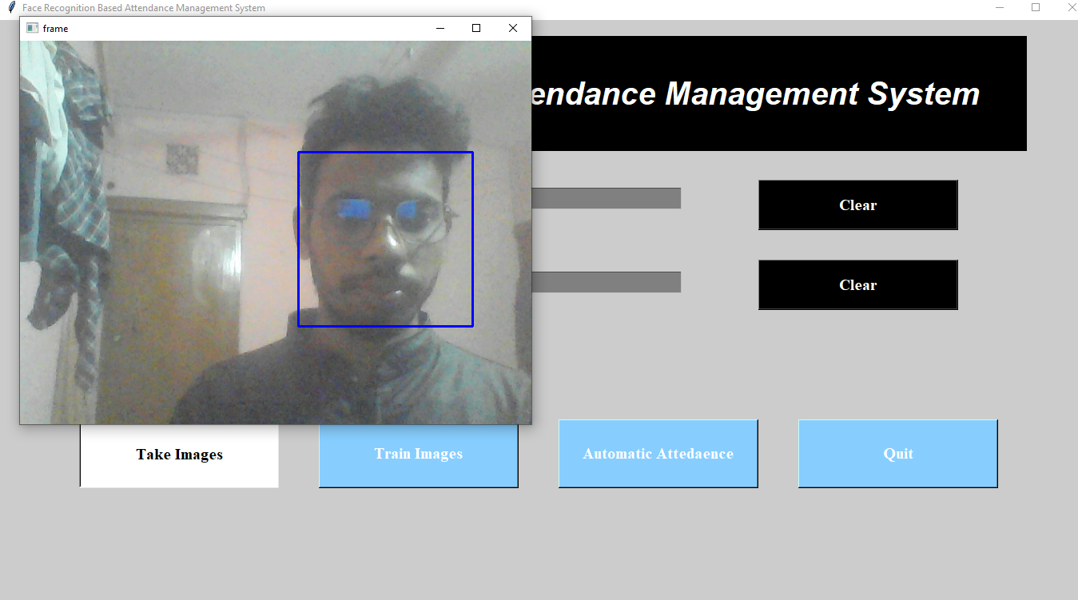
Take Images
Taking images for train up model.

Slide 12

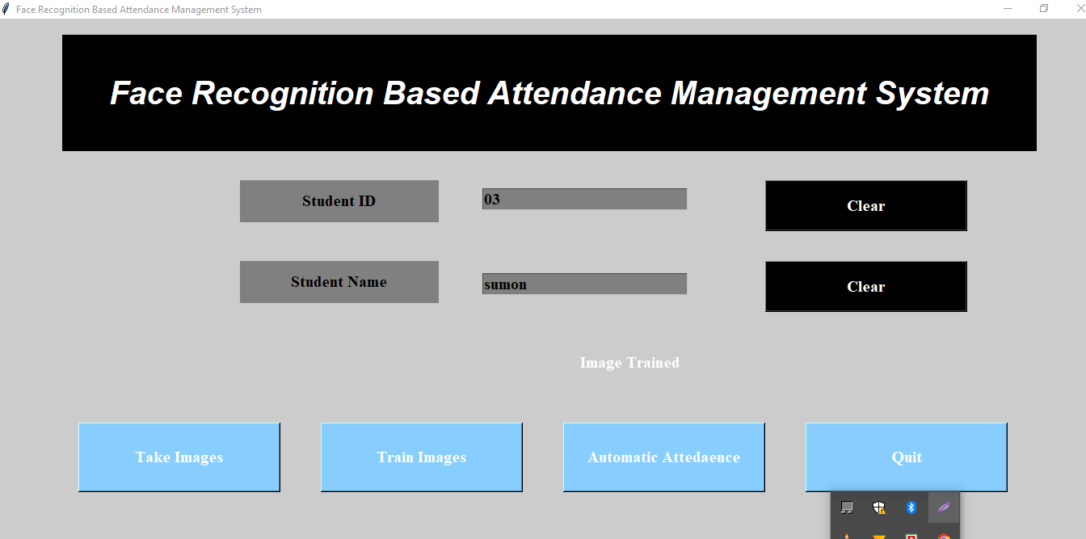
Train Images
This section train the model

Slide 13

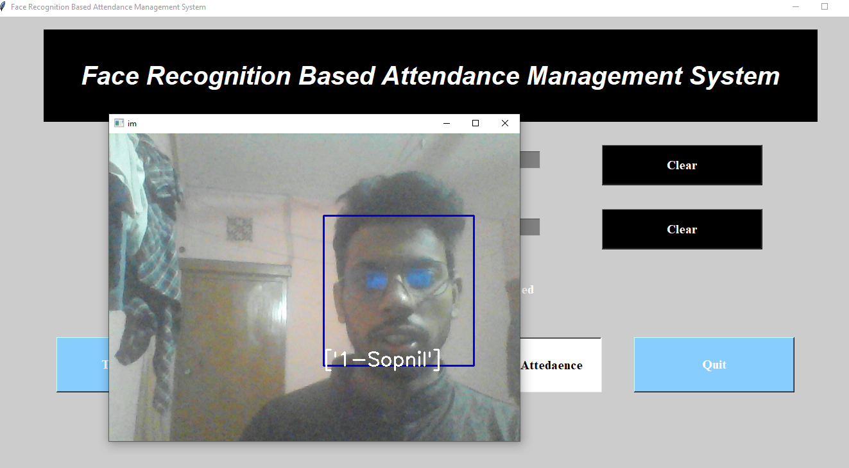
Automatic Attendance
This section identify the image

Slide 14

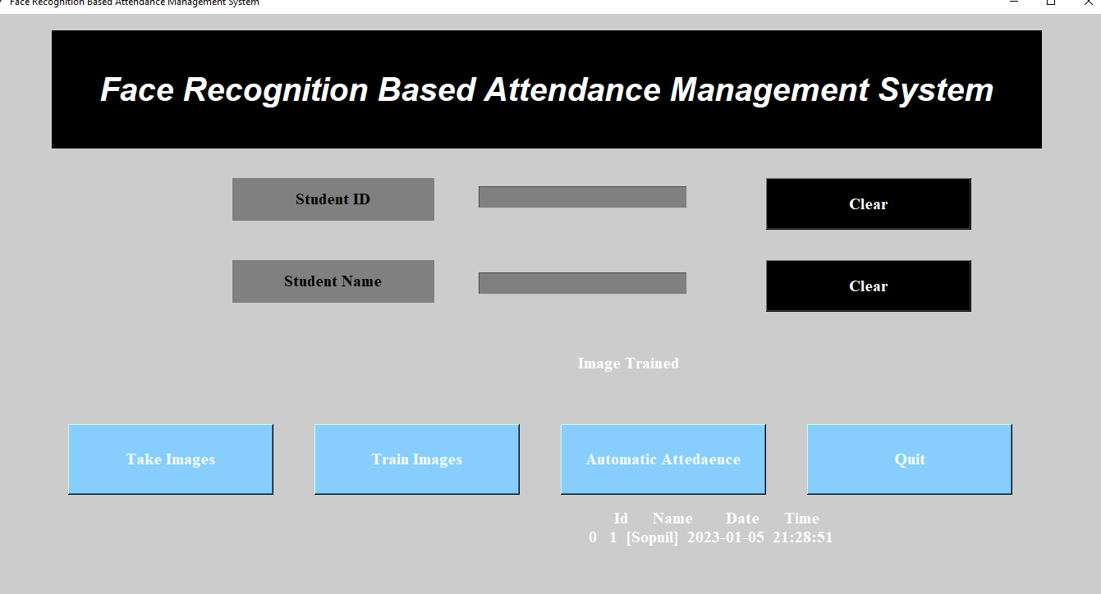
Output
This is output

Slide 15

Student Informations Table’s

Slide 16
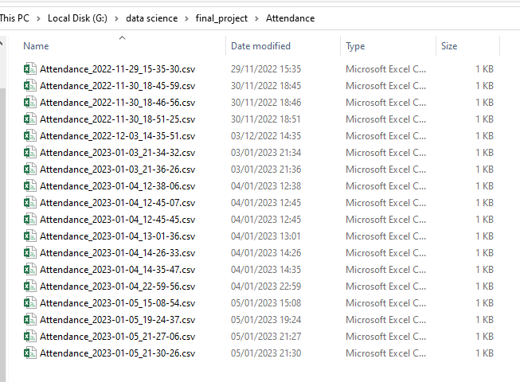
Attendance file

Slide 17
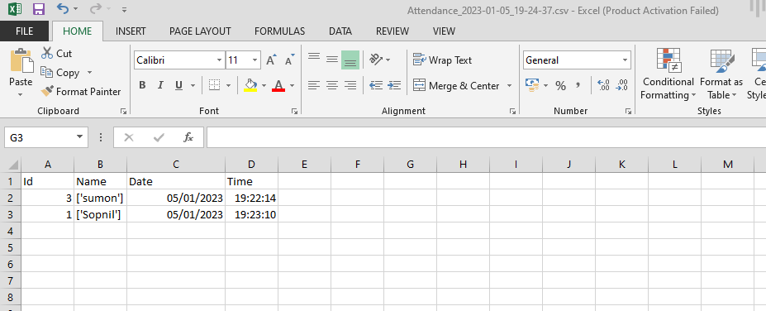
Attendance Date & Time

Slide 18

Objectives
The main purpose of this project is to build a human face recognition for an institute or organization to mark the attendance of their students or employees. It is a subdomain of Object Detection, where we try to observe the instance of semantic objects. This system is fully automated and easily deployable

Slide 19
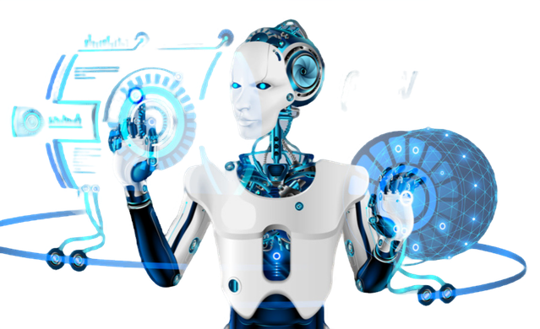
Future Work
The following are the future work for the project.
School management system.
Employee management system
Create a mobile app

Slide 20

Conclusion
Smart attendance management system is designed to solve the issues of existing manual systems. We have used face recognition concept to mark the attendance of student and make the system better. The system performs satisfactory in different poses and variations. In future this system need be improved because these system sometimes fails to recognize students from some distance, also we have some processing limitation, working with a system of high processing may result even better performance of this system.

Slide 21
Thank You!
Does anyone have any questions?
Sahirulislam.70@gmail.com
01788265670

